Slide 1

EMPLOYEE ATTRITION ANALYSIS
BY
S.PRANOV

Slide 2
PROBLEM STATEMENT
XYZ company which was established a few years back is facing around a 15% attrition rate for a couple of years. And it's majorly affecting the company in many aspects. In order to understand why employees are leaving the company and reduce the attrition rate XYZ company has approached an HR analytics consultancy for analyzing the data they have. You are playing the HR analyst role in this project and building a dashboard which can help the organization in making data-driven decisions.

Slide 3
INTRODUCTION
    XYZ Company is facing a persistent attrition rate of 15%, impacting productivity and team morale. To address this challenge, we are collaborating with an HR analytics consultancy to analyze employee data and uncover the root causes of turnover.
  This project aims to develop an interactive dashboard that visualizes key metrics, such as demographics, tenure, and exit reasons. By leveraging these insights, XYZ Company can implement targeted retention strategies and foster a more engaged workforce, ultimately supporting long-term organizational success.

Slide 4
MAIN KEY METRICS
ATTRITION BY AGE
ATTRITION BY EDUCATION FIELD
ATTRITION BY YEARS AT COMPANY
EMPLOYEE COUNT BY BUSINESS TRAVEL
MONTHLY INCOME BY JOBROLE
MONTHLY INCOME BY DEPARTMENTS

Slide 5

POWER BI DASHBOARD ANALYSIS

Slide 6
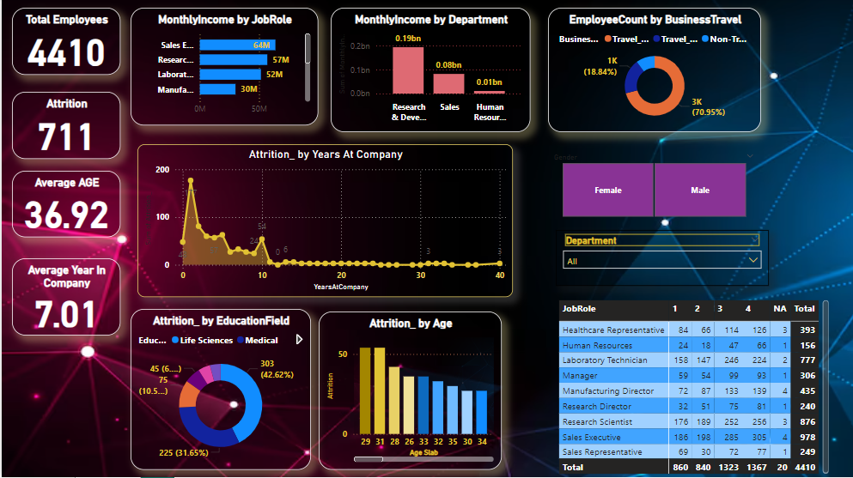
EMPLOYEE ATTRITION ANALYSIS DASHBOARD

Slide 7
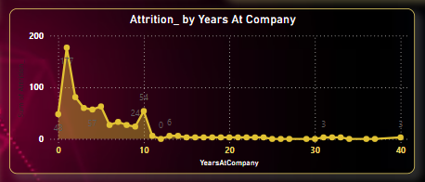
ATRRITION BY YEARS AT COMPANY

Slide 8
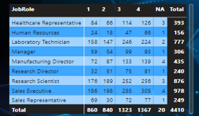
JOB ROLES AND SATISFACTION BY JOBCOUNT

Slide 9
CONCLUSION
1. Data-Driven Insights: The comprehensive analysis and interactive dashboard provided XYZ Company with actionable insights into the factors contributing to employee turnover, enabling HR leaders to identify specific areas for improvement.
2. Targeted Retention Strategies: By understanding the root causes of attrition, XYZ Company can implement targeted initiatives—such as enhanced engagement programs and career development opportunities—that address employee concerns and foster a supportive work environment.
3. Sustained Organizational Success: With ongoing monitoring of attrition metrics and the ability to adapt strategies based on data, XYZ Company is well-positioned to reduce turnover, enhance employee satisfaction, and ultimately achieve sustained business growth.
                .

